Slide 1
StudyMate AI
Smart Learning Assistant

Slide 2
Problem Statement
Students deal with large volumes of unstructured notes and study materials
Difficult to quickly find relevant information from notes
Traditional learning methods lack interactive doubt-solving support
Manual revision and quiz preparation require significant time and effort
Existing systems do not provide personalized or context-aware learning assistance

Slide 3
Objectives
Build an intelligent learning assistant that enables answering questions directly from user-uploaded notes with accurate, context-aware responses.
Automate quiz generation (MCQs) and provide clear, multi-level explanations to enhance student learning efficiency and engagement.

Slide 4
System Overview
StudyMate AI is an AI-based learning assistant
Allows users to upload notes
Extracts and processes text from notes
Converts text into embeddings
Stores data in FAISS vector database
Retrieves relevant content for user queries
Uses LLM to generate answers
Generates quizzes and explanations

Slide 5
System Architecture
Frontend provides user interface for upload, chat, and quiz
Backend (FastAPI) handles all processing and API requests
SQLite database stores notes, chats, and quiz data
FAISS stores embeddings for semantic search
LLM generates answers based on retrieved content

Slide 6
Data Processing
Extract text from PDF, DOCX, and TXT files
Split text into smaller chunks
Use overlap to maintain context
Convert chunks into embeddings
Prepare data for retrieval

Slide 7
Vector search
Stores embeddings of text chunks
Performs similarity search
Retrieves most relevant content
Enables semantic search instead of keyword search
Improves answer accuracy

Slide 8
LLM
Uses LLM to generate responses
Takes retrieved content as input
Provides context-based answers
Supports different response types
Improves learning experience

Slide 9
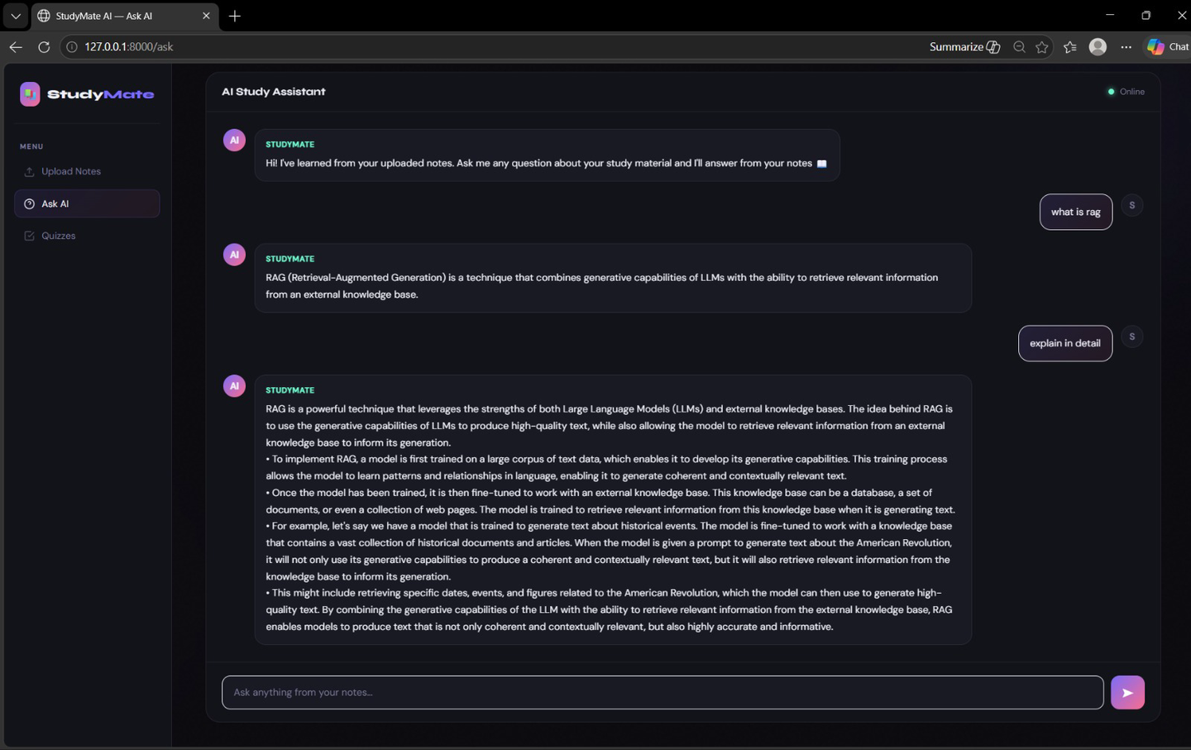
Output

Slide 10
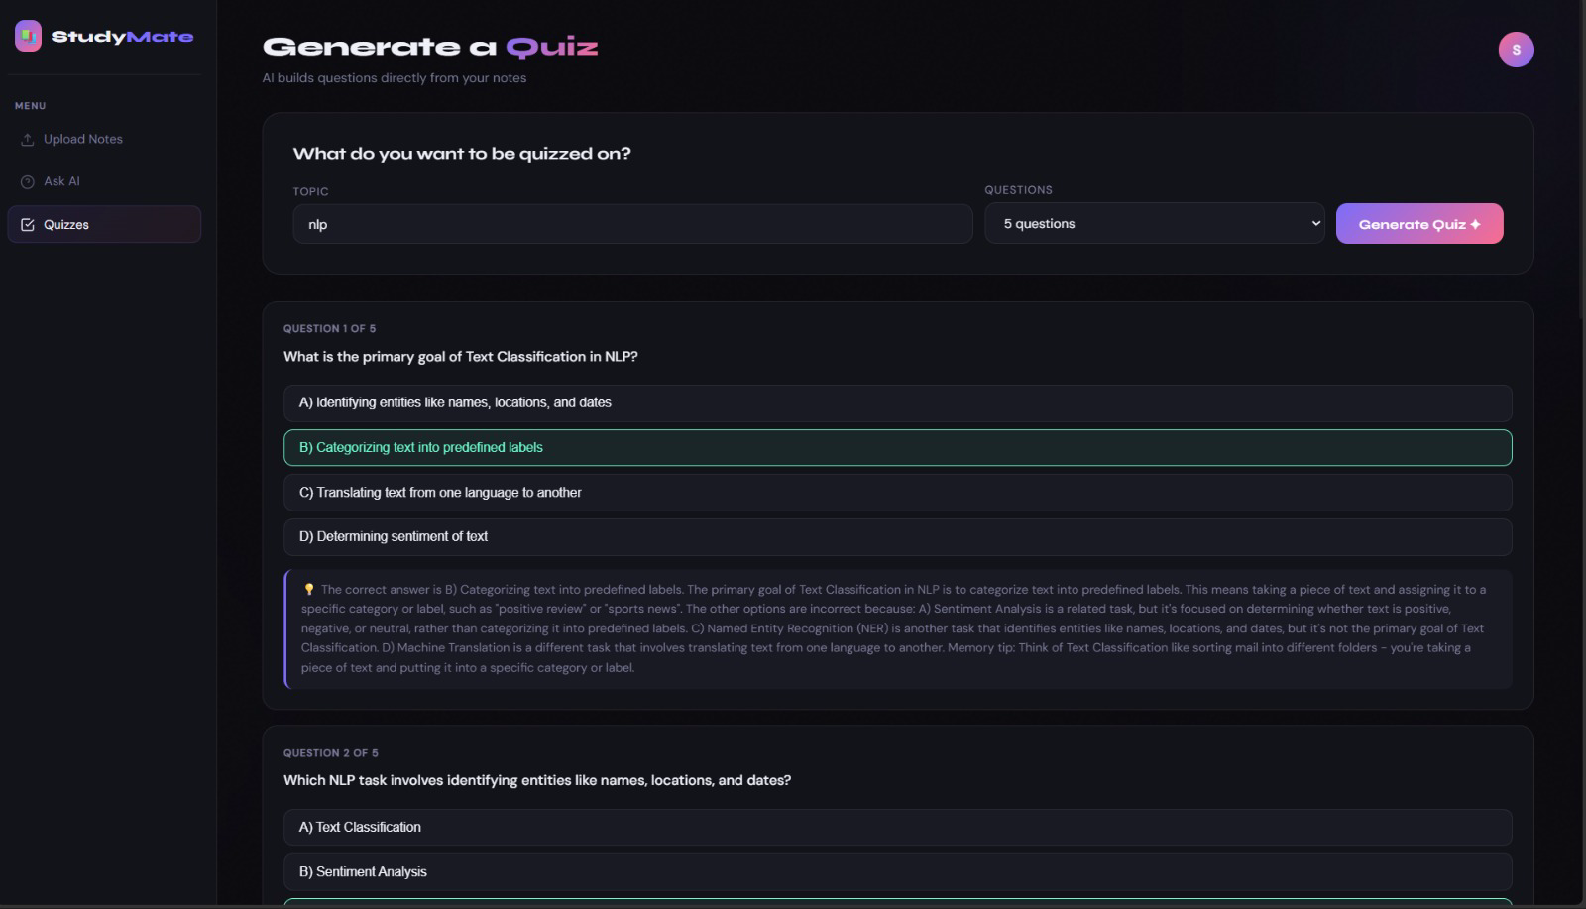
Output

Slide 11
Conclusion
Users can upload notes easily
System answers questions instantly
Generates quizzes automatically
Provides clear explanations
Improves study efficiency

Slide 12
Thank
You!

